Slide 1
NY 311 Analysis
CIS9650 Group

Slide 2
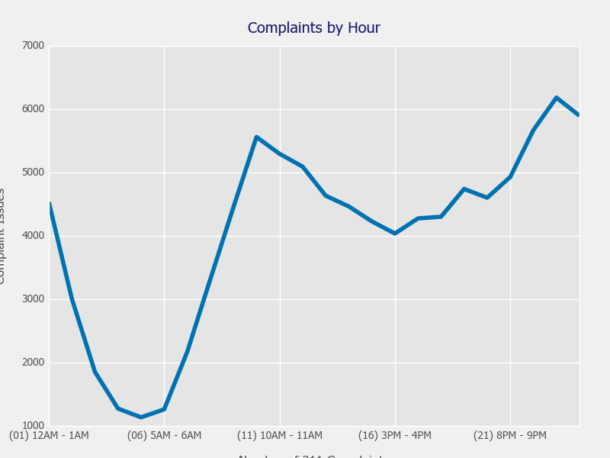
WHEN
do New Yorkers complain?
Evening Peak Hour:
9PM - 10PM
Morning Peak Hour:
9AM - 10AM

Slide 3
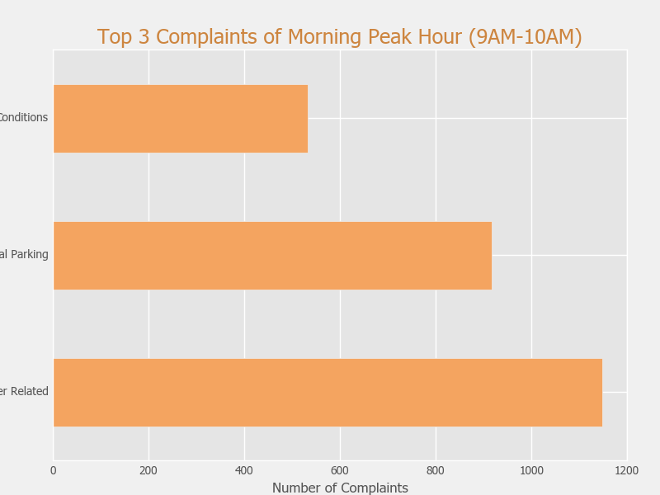
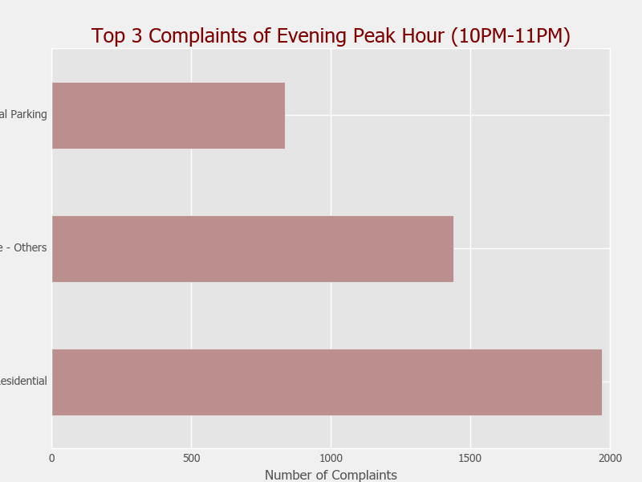
WHAT
do New Yorkers complain about?
Conditions
Illegal Parking
Illegal Parking
Noise - Others
Heat/Water Related
Noise - Residential

Slide 4
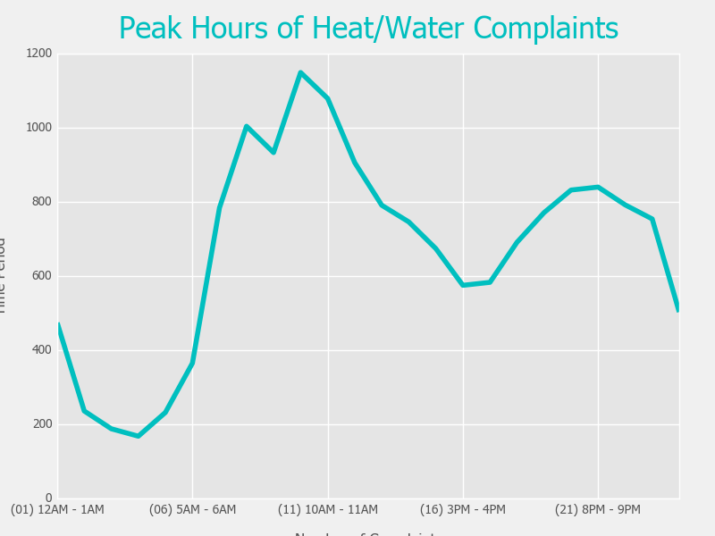
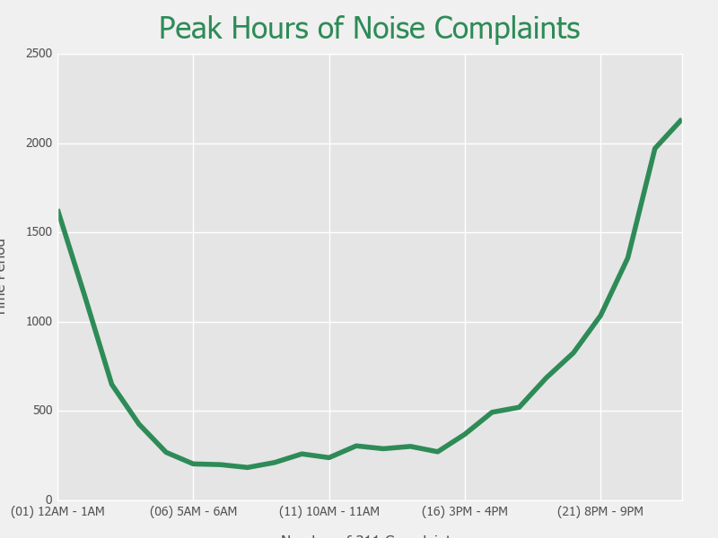
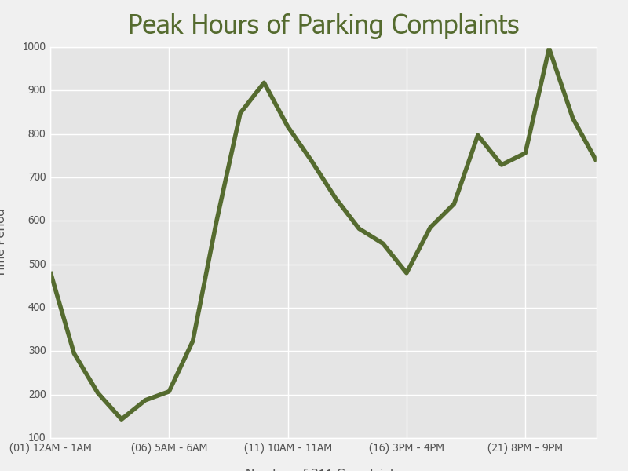
WHAT
do New Yorkers complain about?
Morning Issue:
Heat/Water
Evening Issue:
Noise
All-day Issue:
Illegal Parking

Slide 5




WHY
do New Yorkers complain?
We explore these areas
1
2
3
4
Air
Quality
Mass
Shooting
Game
Releases
President Popularity

Slide 6
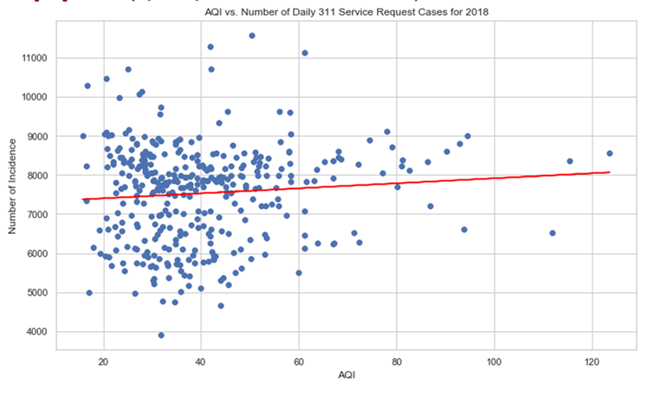
AIR QUALITY
The red fitted line is almost flat, which indicates a little correlation between AQI and number of 311 service requests.
1
2
3
4

Slide 7
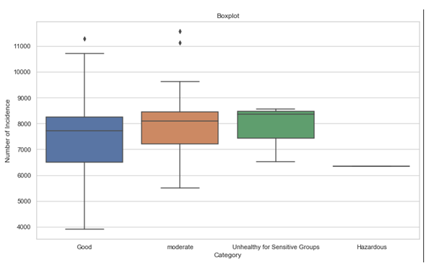
AIR QUALITY
The median line in each of the boxplot shows that there is no statistically significant difference in number of incidence when having different types of days.
1
2
3
4

Slide 8
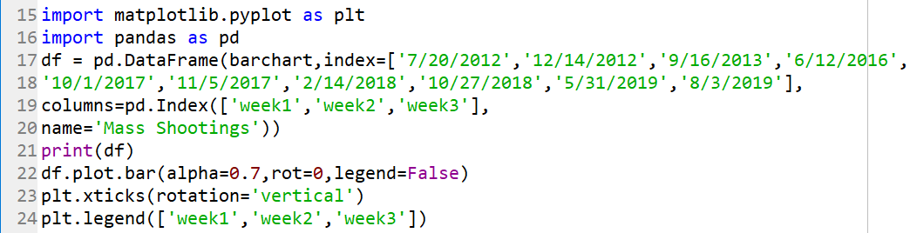
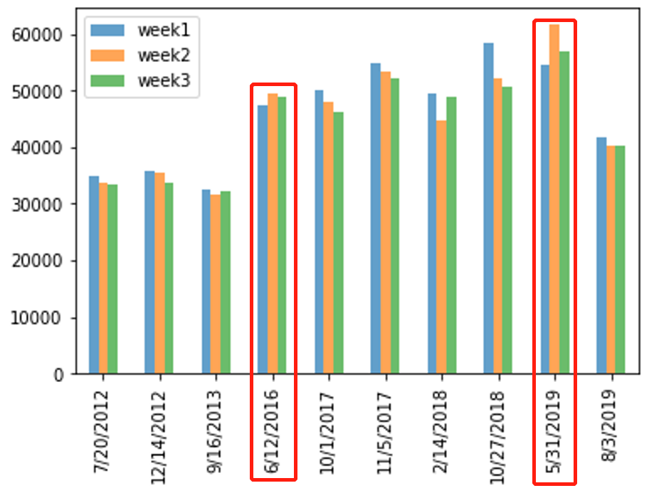
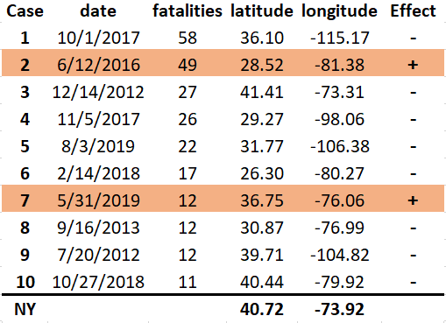
MASS SHOOTING
1
2
3
4

Slide 9
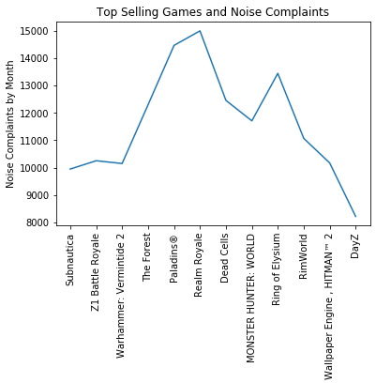
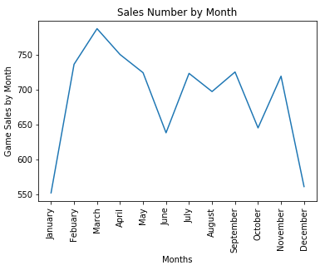
GAME RELEASES
Correlation coefficient between noise complaints and Steam game sales:
0.30560745158410146
1
2
3
4

Slide 10
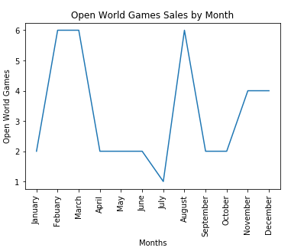
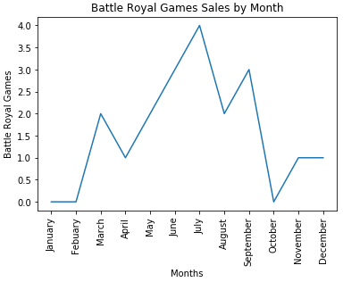
GAME RELEASES
Correlation coefficient between noise complaints and Open World game sales:
-0.5123576669830741
Correlation coefficient between noise complaints and Battle Royal game sales:
0.6226200024975854
1
2
3
4

Slide 11
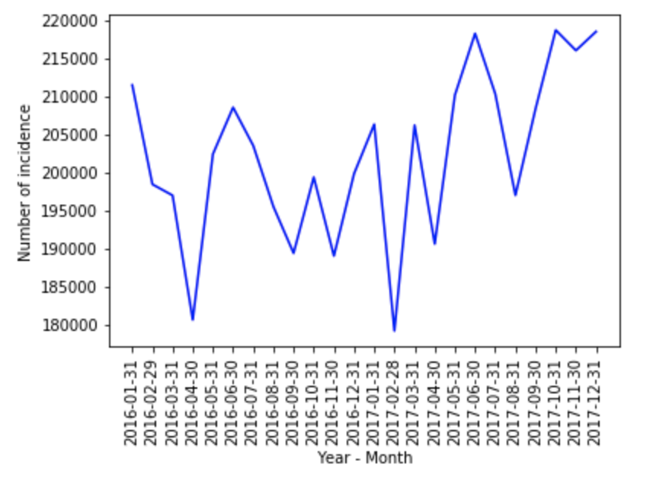
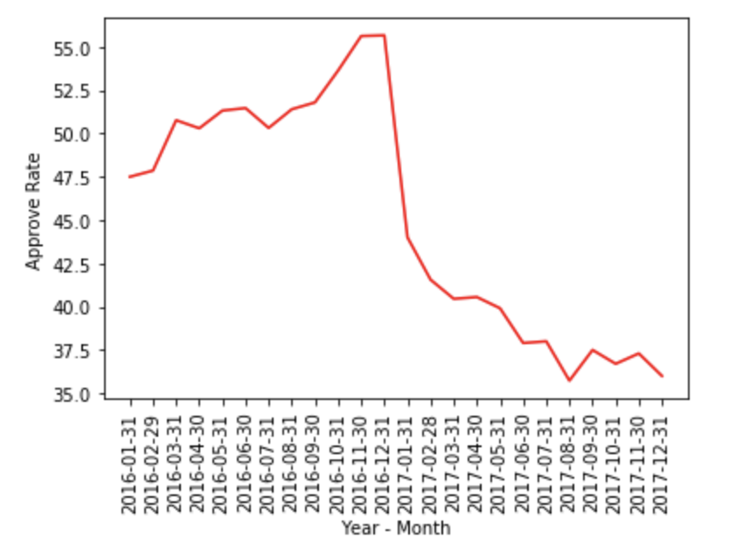
PRESIDENT POPULARITY
1
2
3
4

Slide 12
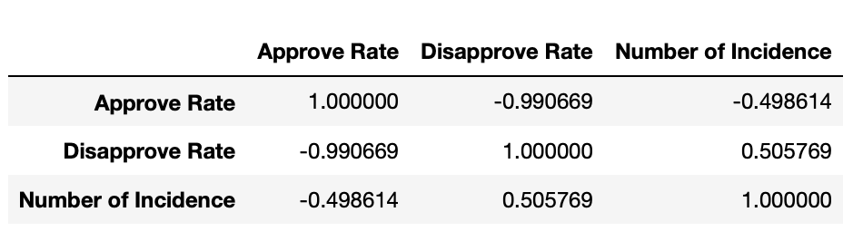
PRESIDENT POPULARITY
1
2
3
4

